Slide 1
Ecology

Slide 2
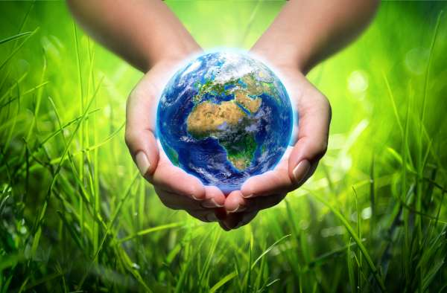
Ecology is a science about the structure and functioning of nature, which deals with the study of interactions between organisms and their environment and between them (i.e. the structure of ecosystems).

Slide 3
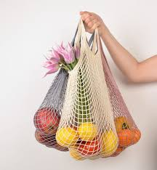
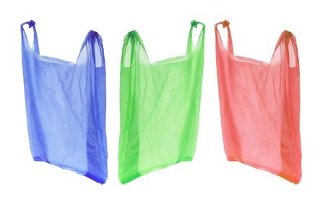
Some people don’t care about our planet at all. Beacuse of this, about 6 million people died every year. Instead of disposable, plastic shopping bags, buy for a lot of money.

Slide 4
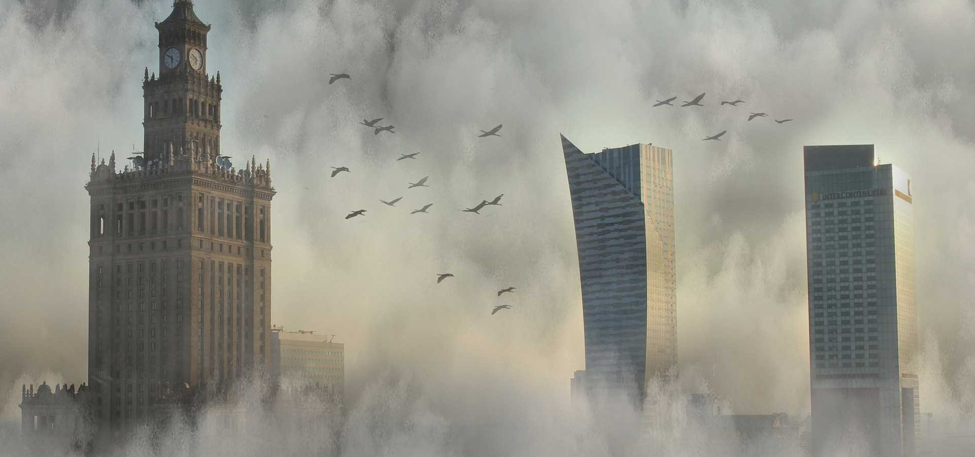
In 2010, around 230 000 people around the world died from smog. Some people smoke plastic in their ovens, e.g. they burn plastic nets, they smoke bottles...

Slide 5
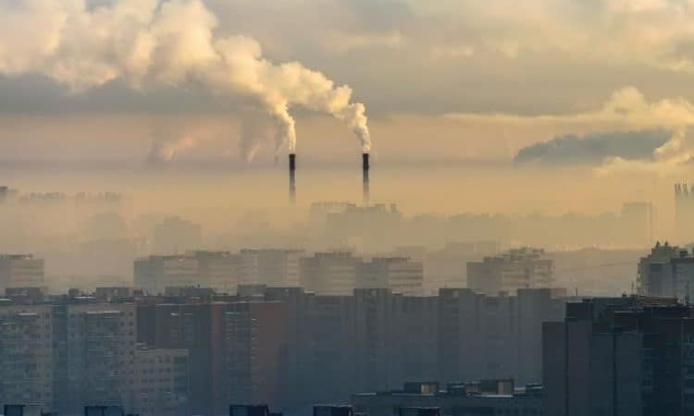
Smog is most often created in large cities such as Warsaw, Krakow, London and so on.

Slide 6
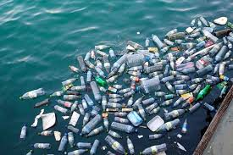
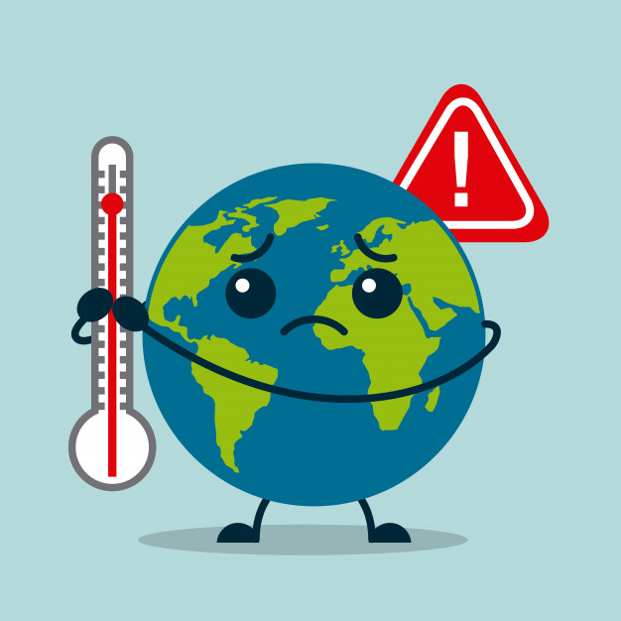
Our planet is dying by people who burn plastic ... Tons of plastic float in the seas, and garbage is scattered everywhere in the woods. All people should segregate garbage, e.g. paper, plastic, etc.

Slide 7
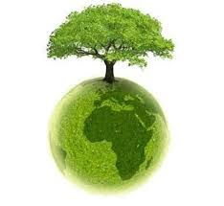
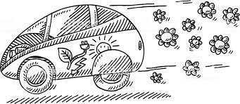
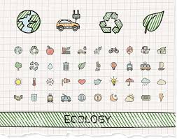
A man named Robert Anderson came up with electric cars that do not produce smog and are environmentally friendly.
Eco car

Slide 8
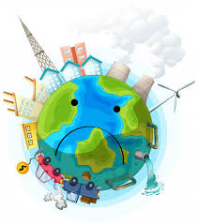
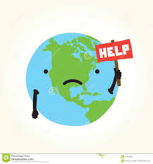
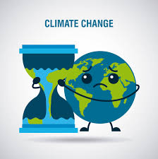
Be like me! Be ,, I am eco friendly! "Plant trees - do not cut, collect rubbish - do not scatter, just be a friend of nature!
E
C
O
L
O
G
Y

Slide 9
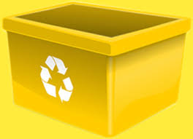
Garbage segregation is very important on our planet, so now I will show you how to do it.
- Red arrows tell us to throw metal here.
- Blue, paper.
- Green requires glass.
- Black are mixed .
- Bio waste must be in the brown bin.
- Yellow are waiting for plastic.

Slide 10
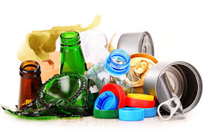
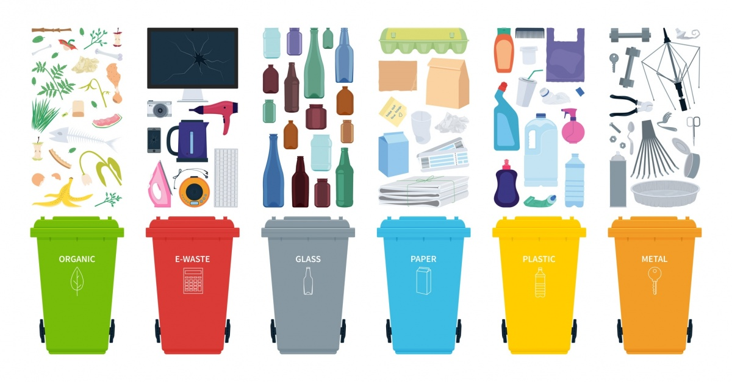
English segregation of rubbish is a little different than Polish, but that's okay. In the photo below it is shown.

Slide 11
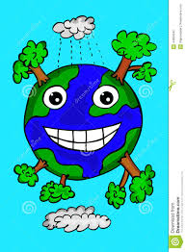
I am very grateful to you for watching my presentation, I think you liked it and invite you to become "I am environmentally friendly". Thank you and best regards.
Zosia Markowska

