Slide 1
I Am Eco-Friendly!
Ecology

Slide 2
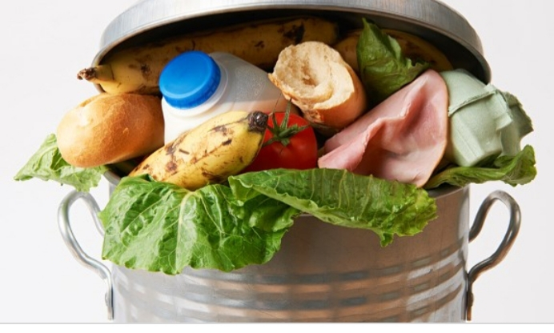
Don’t waste food!

Slide 3
Save water!

Slide 4
Save energy!

Slide 5
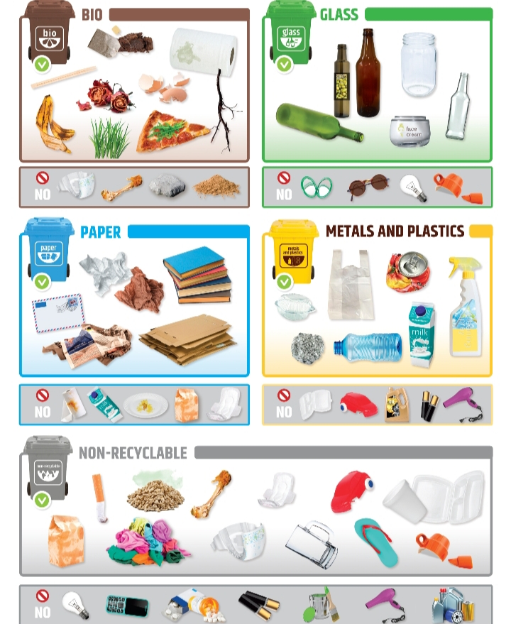
Segregate rubbish!

Slide 6
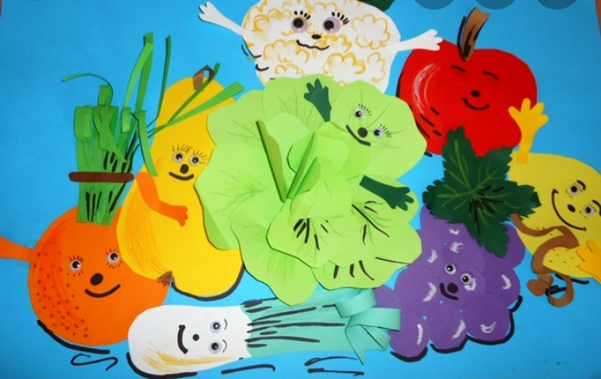
Eat organically!

Slide 7
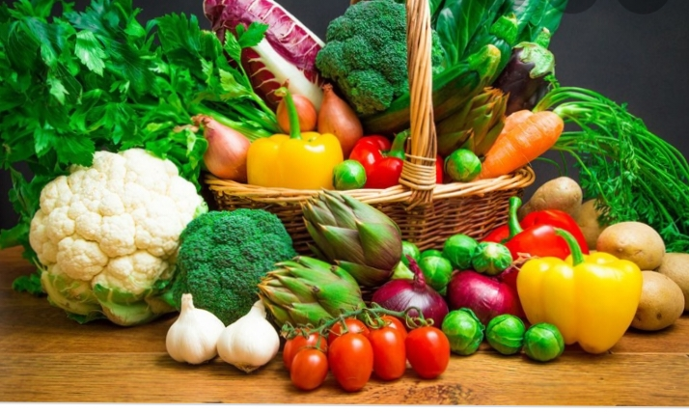
Buy locally and seasonally!

Slide 8
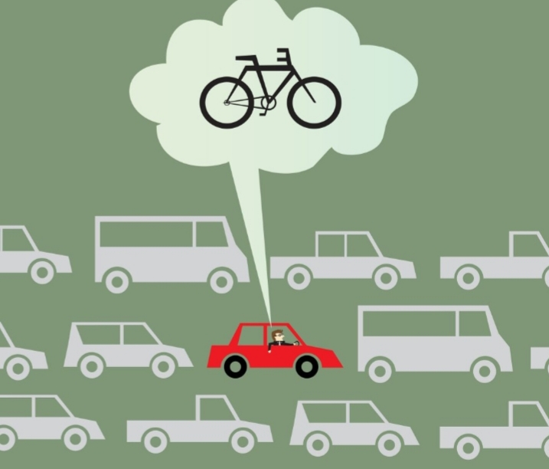
Replace the car with a bicycle!

Slide 9
Clean and wash It ecologically!

Slide 10
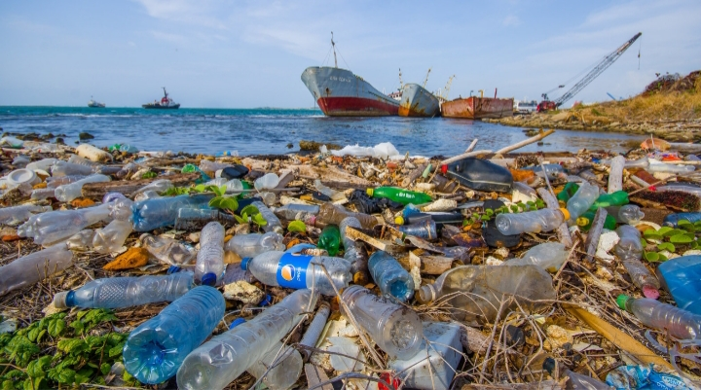
Limit plastic and disposable packaging!

Slide 11
Be happy and live in friendly ecology!

Slide 12
Remember eco-energy is health!!!

