Slide 1
I’M ECO-FRIENDLY!
Create by: Gabriela Zubek

Slide 2
8 important rules to become eco-friendly

Slide 3
1. Segregate rubbish!
The planet is our home, which should be clean and tidy. This is not always the case. Recycling has a lot of benefits. Waste segregation allows it to be processed in the recycling process in the next stage. For example, waste paper separation reduces energy, water and air pollution as well as cutting down trees.

Slide 4
2. Save water!
Water is a good that we use every day. For most of us, free access to drinking water is something obvious. Around 1.1 bilion people do not have access to water that meets basic cleanliness standards. Let’s remember about saving water!

Slide 5
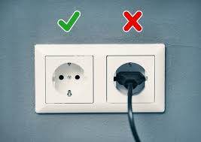
3. Take electronic equipment out of contact!
Not everyone is aware that turning off electronic devices does not mean that they stop using electricity. Just unplug them from the socket. However, if the device is connected to the socket for several hours, this is an error.

Slide 6
4. Use reusable bags!
By using reusable bags, you also contribute to supporting zero waste life, which promotes raising awareness of our impact on the environment. It is a Eco-friendly solution. Shopping without plastic can be really very easy, and more and more stores allow and support shopping for their own packaging.

Slide 7
5. Buy sparingly!
We should buy sparingly. Thanks to this we also save money. Let's use the rebates and discounts that await us online. Just search!

Slide 8
6. limit buying newspapers, books and magazines!
Most books, magazines or newspapers are now available online. Each of us can easily search for many magazines or books. Let's save them buying!

Slide 9
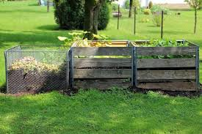
7. Set a place for a composter!
Organic waste in our gardens is generated almost all year round. Mown grass, trimmed tree branches, dug old plants or raked leaves - all this must find its place. Many people choose to dispose of organic waste to appropriate landfills.
Meanwhile, it is much better to invest in a composter.

Slide 10
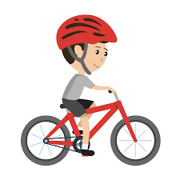
8. Ride a bike!
By moving a bicycle every day we create the opportunity to increase physical activity. By switching to a bicycle from our budget, we can cross out such things as expenses for public transport or gasoline for the car. By switching to a bicycle, you take care of the environment, because the bicycle does not generate exhaust gases. Not only will you improve your overall physical fitness, you will also reduce the noise level.

Slide 11
Thank you for your attention!
Create by: Gabriela Zubek

